Slide 1

ESTIMATION OF TIME OF DEATH
BY – THE TECHNOS

Slide 2

Since death is certain and the time of death is uncertain, what is the most important thing?

Slide 3
PROBLEM STATEMENT
To estimate the time of death is merely possible through forensics department but it would take so much time to calculate the accurate time by analysing the tissues which would decay slowly. So we have find a new methodology to determine the time of death with maximum accuracy using the concepts of IoT.

Slide 4

Estimating the time of death for the deceased is something else that the pathologist will have to do during the course of his autopsy procedures. In addition to this he or she may be called upon at the scene of a crime whilst carrying out their external examinations to try and judge - or best guess - when the victim died.

Slide 5

We have coded the method of estimating the time of death of a corse by using NEWTON’S LAW OF COOLING which implies that
“Newton's Law of Cooling. Newton's Law of Cooling states that the rate of change of the temperature of an object is proportional to the difference between its own temperature and the ambient temperature”

Slide 6
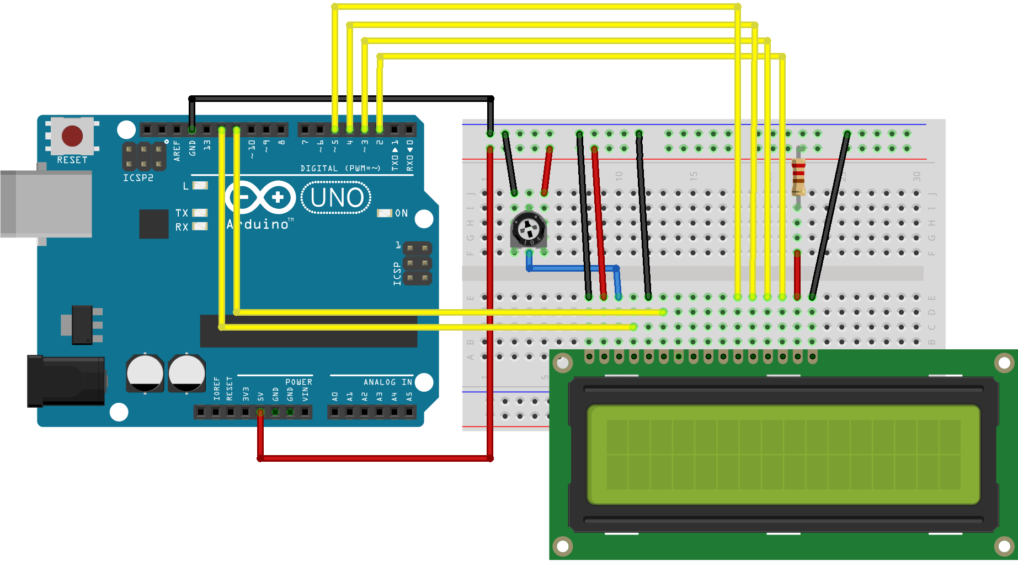

Slide 7
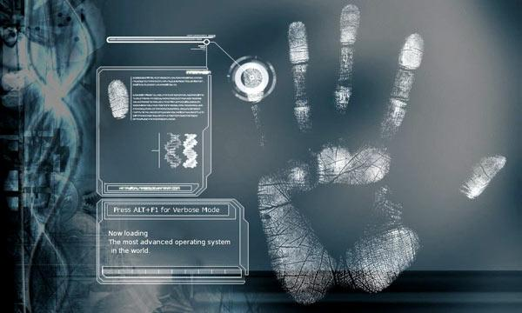
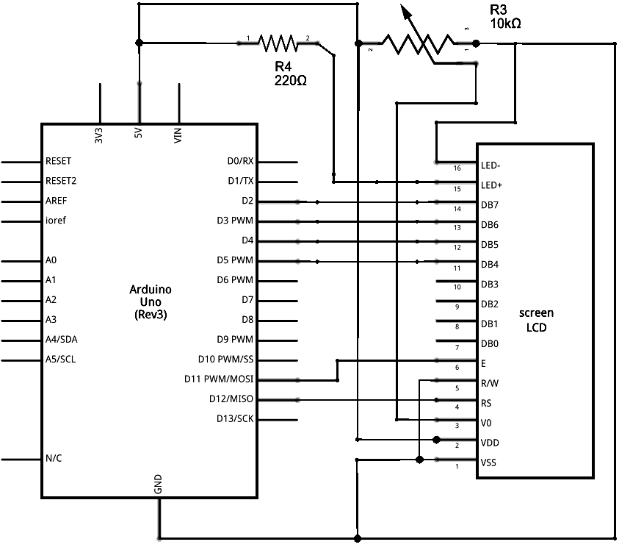

Slide 8
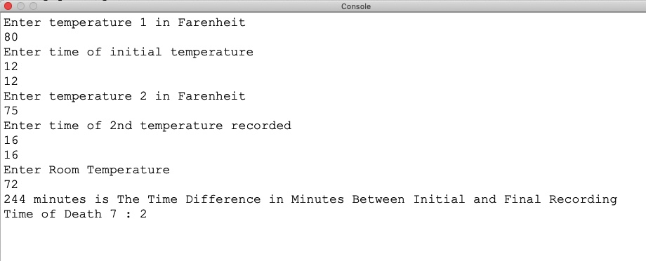
Experimental Result

Slide 9

ADVANTAGES
An accurate estimation of the time of death can lead to discovering the identity of the assailant.
In criminal cases, it can eliminate some suspects while focusing attention on others.
For example, a husband says that he left for a business meeting at 2 P.M. and returned at 8 P.M. and find his wife dead. He says that he was home all morning and that she was alive and well when he left. If the ME determines the time of death was between 10 A.M. and noon, the husband has a great deal of explaining to do. On the other hand, if the estimation reveals that the death occurred between 4 and 6 P.M., and the husband has a reliable alibi for that time period, the investigation will move in a different direction.

Slide 10
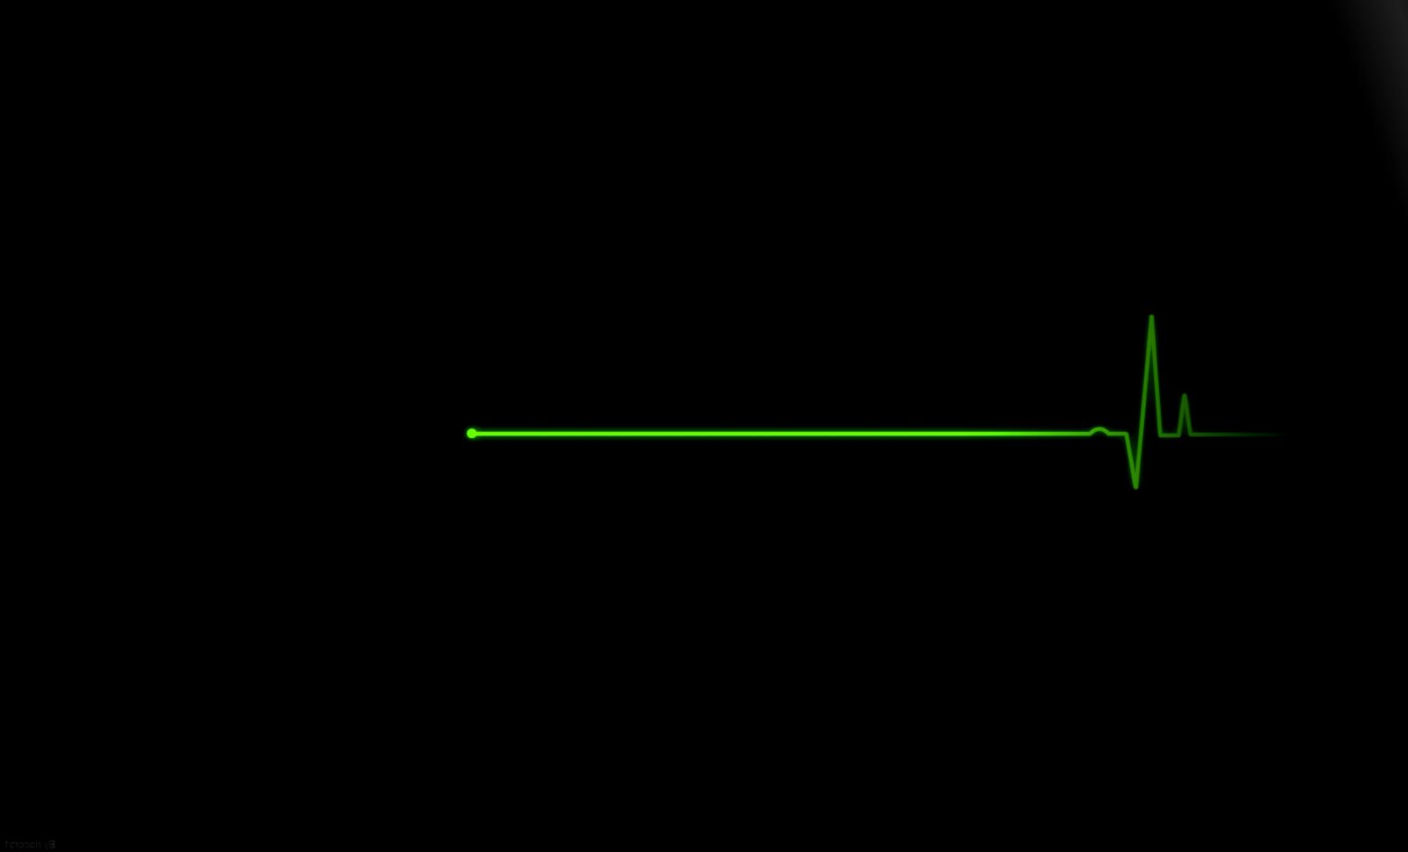
The time of death is not confined to criminal investigations; it can also come into play in civil situations. Insurance payments may depend upon whether the insured individual were alive at the time the policy went into effect or if he died before the policy expired.
The Estimation of Time of Death can be determined in a short duration when compared to autopsy methodology in the financial world.

Slide 11

Demerits
Misconceptions arrives in the calculation if the deceased is found dead for more than 24 hours.
If the environment of the deceased is changed then there is a possibility for the variation of room temperature, hence the results may fluctuate.

Slide 12
Future Enhancements
With Machine Learning as the domain this experiment can be enhanced with real time post-mortem reports to compare its efficiency and increase accuracy with deep machine learning.

Slide 13
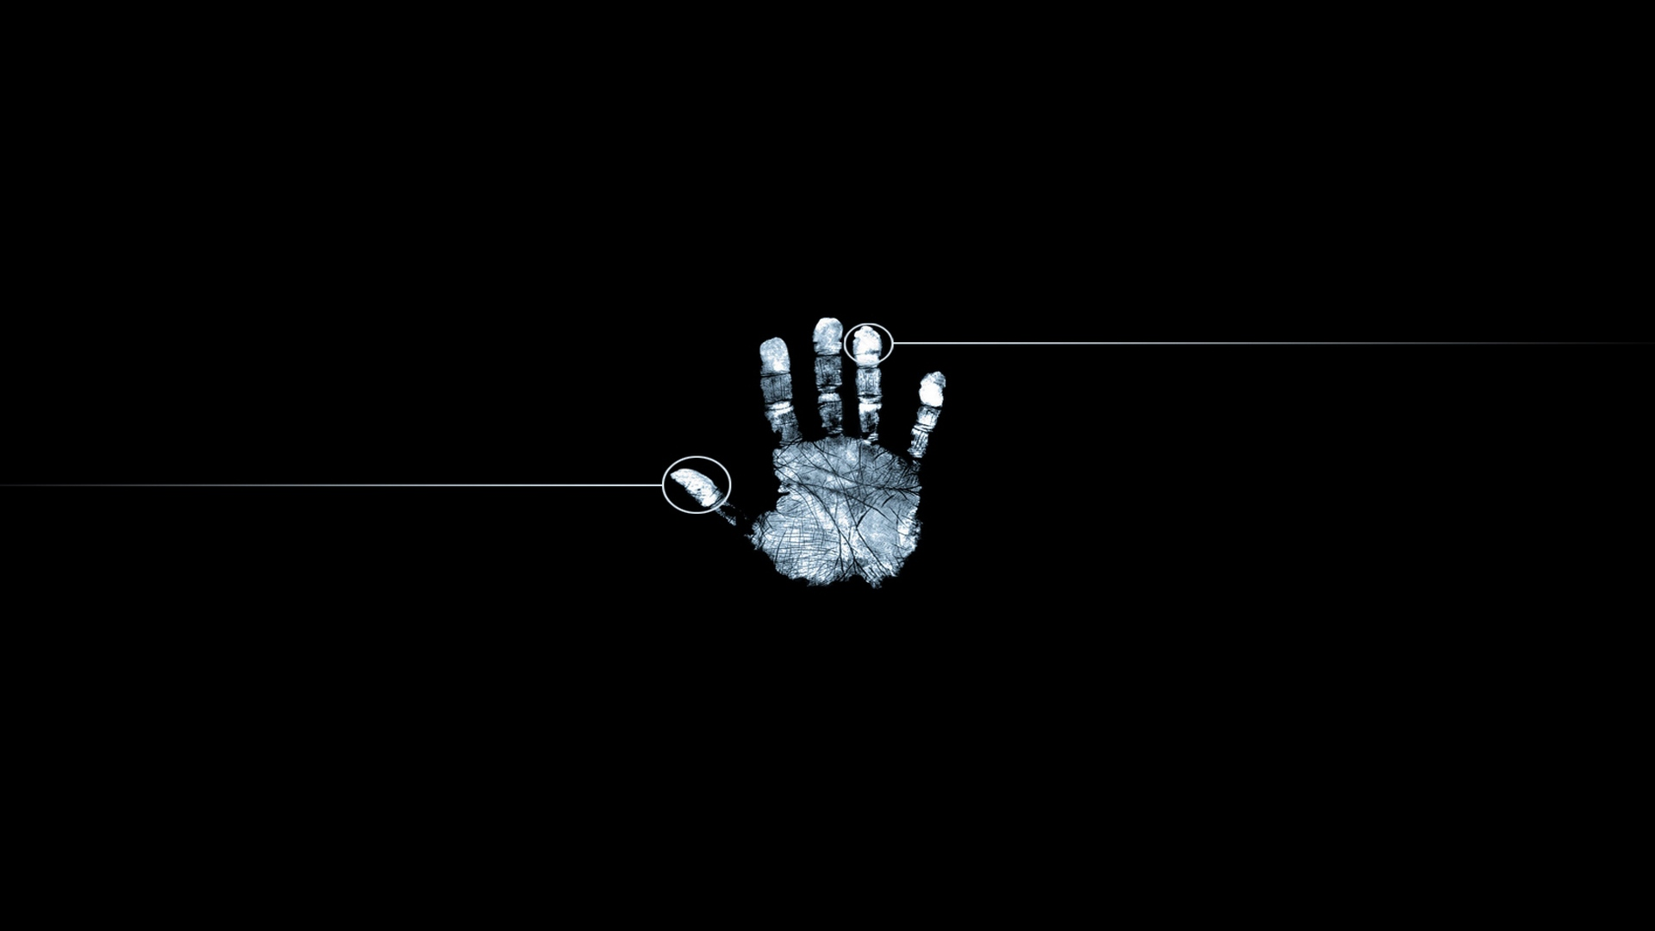

Slide 14
DONE BY PIYUSH KUMAR MALOO SHAIK GOLAM KIBRIYA VIGNESH S

